Slide 1
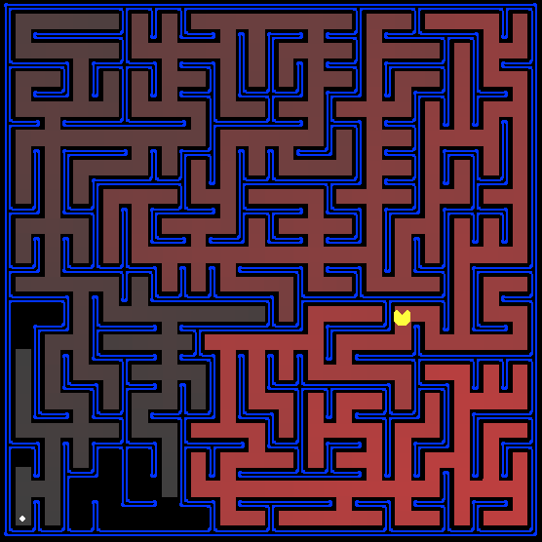
Project 1: Search in Pacman

Slide 2
Graph
A graph consists of a set of nodes and a set of arcs or links connecting pairs of nodes.

Slide 3
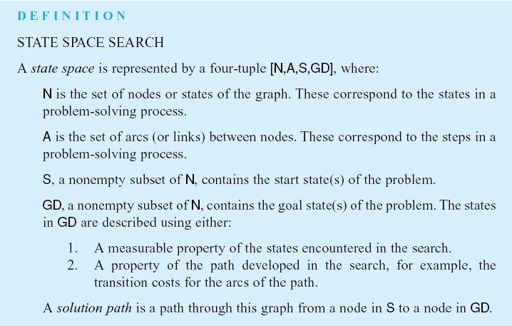
State Space Search
Luger: Artificial Intelligence, 6th edition. © Pearson Education Limited, 2009
Notes:
Insert def box p 88

Slide 4
State space model
In the state space model of problem solving,
the nodes of a graph are taken to represent different configurations of a game board.
The arcs of the graph represent transitions between states. These transitions correspond to legal moves of a game.

Slide 5
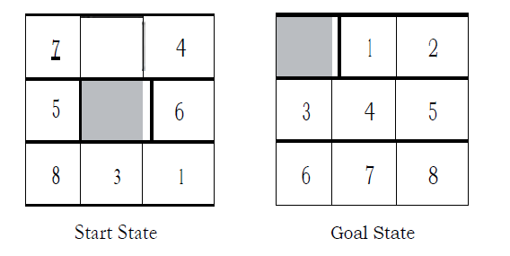
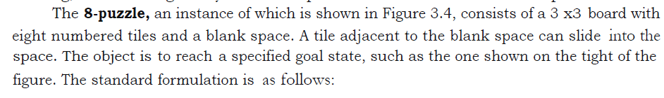
One Player Games

Slide 6
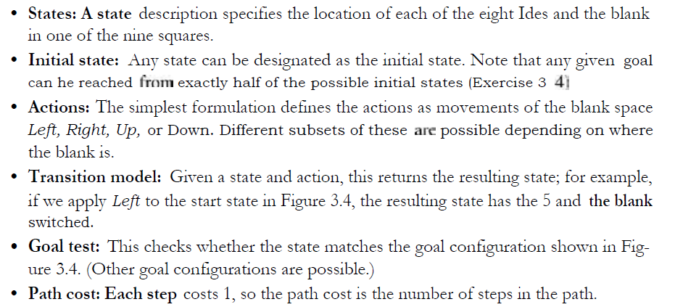

Slide 7
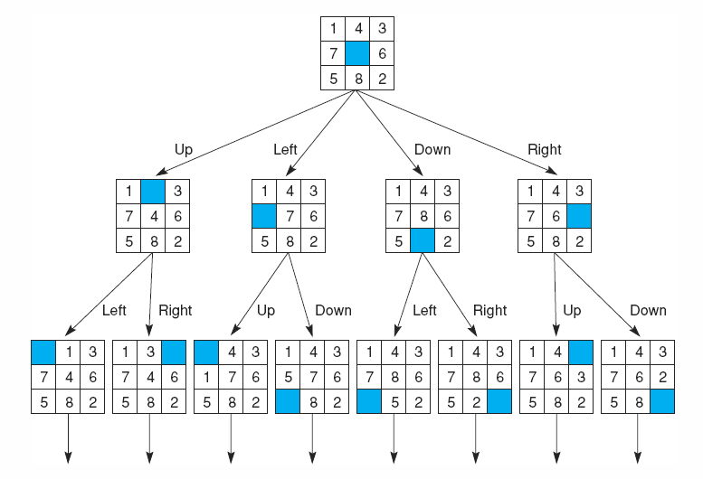
State space of the 8-puzzle generated by “move blank” operations
Luger: Artificial Intelligence, 6th edition. © Pearson Education Limited, 2009

Slide 8
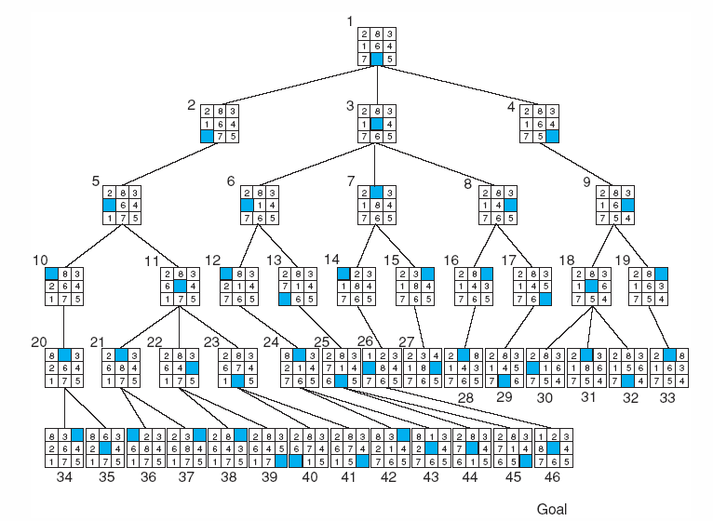
Breadth-first search of the 8-puzzle, showing order in which states were removed from open.
Luger: Artificial Intelligence, 6th edition. © Pearson Education Limited, 2009

Slide 9
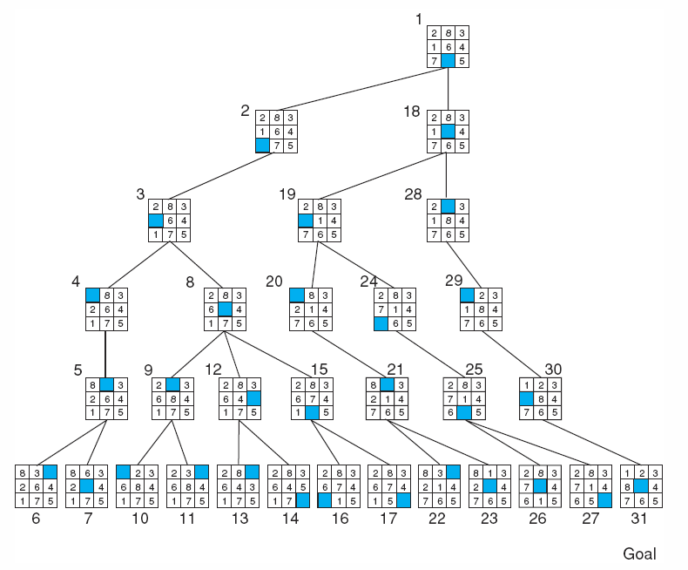
Depth-first search of the 8-puzzle with a depth bound of 5.
Luger: Artificial Intelligence, 6th edition. © Pearson Education Limited, 2009

Slide 10
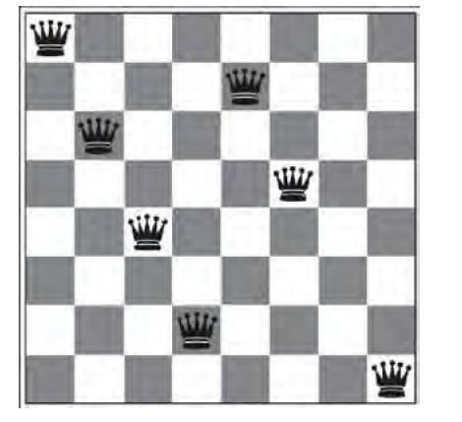
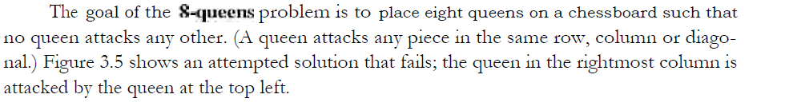
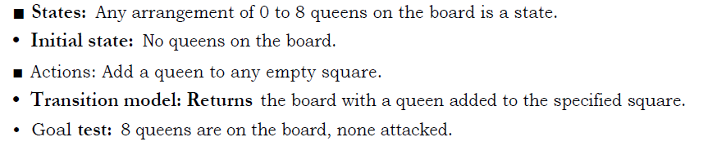

Slide 11
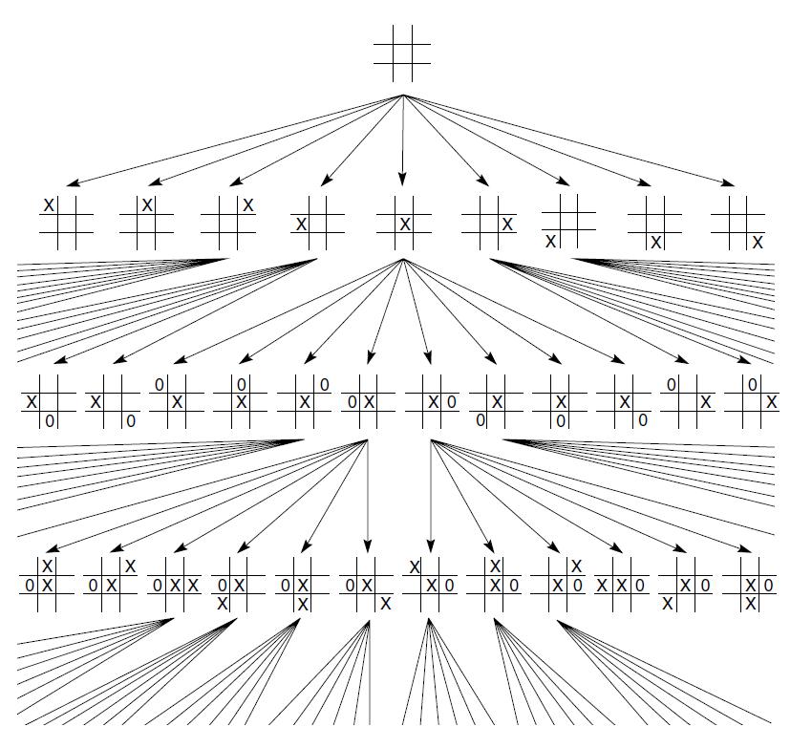
Two Player Games TIC-TAC-TOE

Slide 12
Three goals of Pacman projects
The projects allow students to visualize the results of the techniques they implement.
They also contain code examples and clear directions.
Finally, Pac-Man provides a challenging problem environment that demands creative solutions
Notes:
The projects allow students to visualize the results of the techniques they implement. They also contain code examples and clear directions, but do not force students to wade through undue amounts of scaffolding. Finally, Pac-Man provides a challenging problem environment that demands creative solutions; real-world AI problems are challenging, and Pac-Man is too.

Slide 13

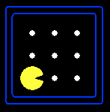





PacMan
A search problem consists of:
A state space
A successor function
(with actions, costs)
A start state and a goal test
A solution is a sequence of actions (a plan) which transfer the start state to a goal state
“N”, 1.0
“E”, 1.0
Notes:
Often comes back on exams
Goal test – sometimes more than one state that satisfies having achieved the goal, for example, “eat all the dots”
Abstraction

Slide 14
State Space Graphs
State space graph: A mathematical representation of a search problem
Nodes are (abstracted) world configurations
Arcs represent successors (action results)
The goal test is a set of goal nodes (maybe only one)
In a state space graph, each state occurs only once!
We can rarely build this full graph in memory (it’s too big), but it’s a useful idea

Slide 15
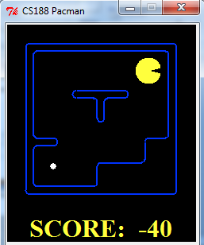
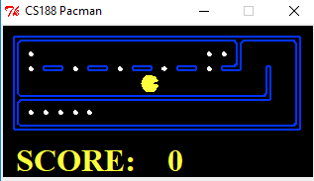
What’s in a State Space?
A search state keeps only the details needed for planning (abstraction)
Problem: Pathing
States: (x,y) location
Actions: NSEW
Successor: update location only
Goal test: is (x,y)=END
Problem: Eat-All-Dots
States: {(x,y), dot booleans}
Actions: NSEW
Successor: update location and possibly a dot boolean
Goal test: dots all false
Notes:
Wrong example for “eat-all-dots”: (x, y, dot count)

Slide 16
PacMan Projects
your Pacman agent will find paths through his maze world. (1) reach a particular location. (2) collect food efficiently.
You will build general search algorithms (BFS,DFS,UCS,A*)and apply them to Pacman scenarios

Slide 17
Welcome to Pacman
After downloading the code (search.zip)…. From (http://ai.berkeley.edu/search.html)
you should be able to play a game of Pacman by typing the following at the command line: python pacman.py

Slide 18
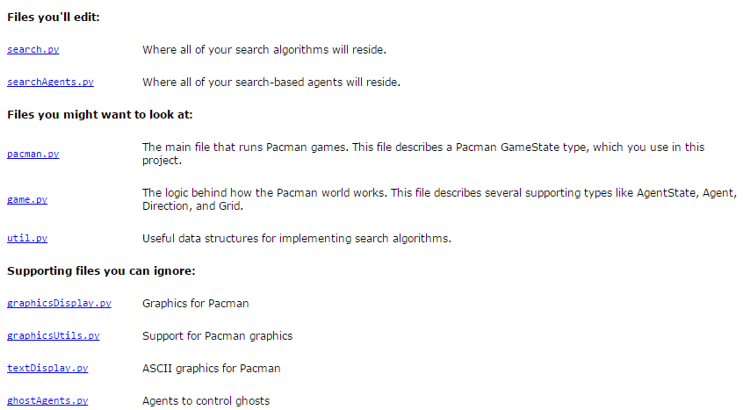
Project Modules

Slide 19
Welcome to Pacman (Cont)
Navigating this world efficiently will be Pacman's first step in mastering his domain.
The simplest agent in searchAgents.py is called the GoWestAgent python pacman.py --layout tinyMaze --pacman GoWestAgent

Slide 20
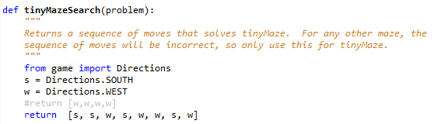
First, test that the SearchAgent is working correctly by running: python pacman.py -l tinyMaze -p SearchAgent -a fn=tinyMazeSearch

Slide 21
Question 1 :Finding a Fixed Food Dot using Depth First Search
In searchAgents.py, you'll find a fully implemented SearchAgent, which plans out a path through Pacman's world and then executes that path step-by-step.
The search algorithms for formulating a plan are not implemented -- that's your job.

Slide 22
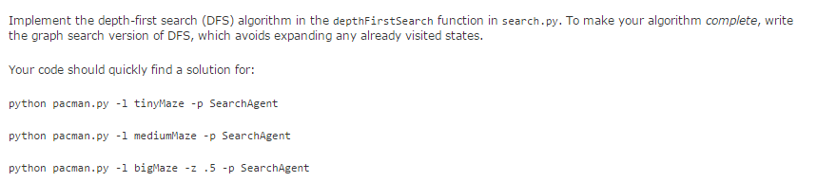

Slide 23
Important note
All of your search functions need to return a list of actions that will lead the agent from the start to the goal. These actions all have to be legal moves (valid directions, no moving through walls).

Slide 24
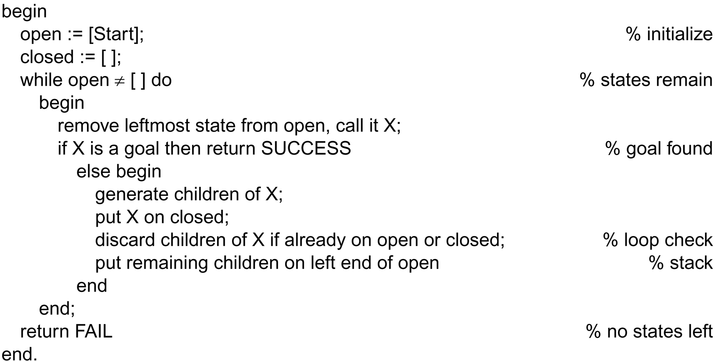
Function depth_first_search algorithm
Luger: Artificial Intelligence, 6th edition. © Pearson Education Limited, 2009

Slide 25
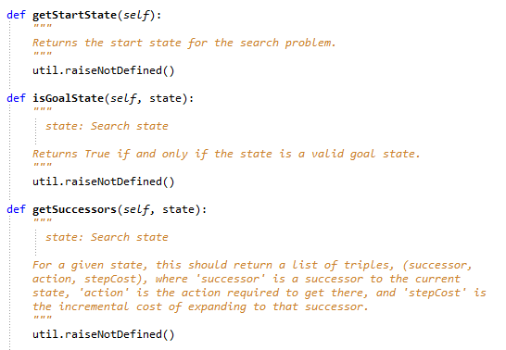

Slide 26
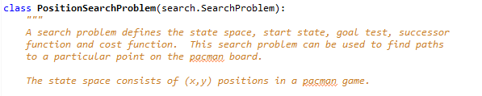
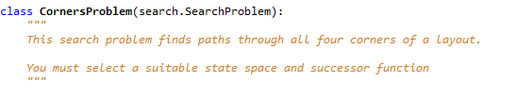
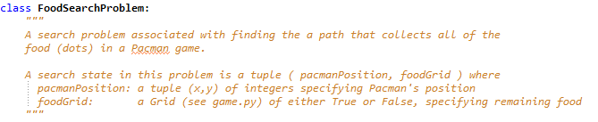

Slide 27
a search node must contain not only a state but also the information necessary to reconstruct the path (plan) which gets to that state.

Slide 28
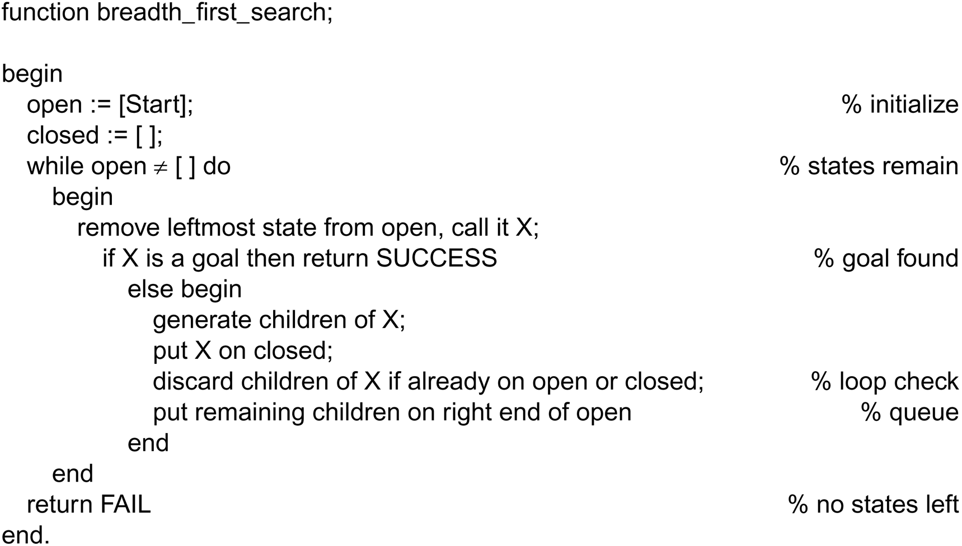
Function breadth_first search algorithm
Luger: Artificial Intelligence, 6th edition. © Pearson Education Limited, 2009

